Slide 1
Heart Failure Prediction
By: Brian Guo & Winston Yang
Machine Learning Final Project

Slide 2
Introduction
Cardiovascular diseases are the leading cause of death
Every 36 seconds one person dies from Cardiovascular disease
Our objective is to predict the possibility of a heart failure
With early detection, doctors can intervene in advance to prevent such deaths

Slide 3
Dataset
11 Features, 918 observations
Age
Sex
Chest Pain Types - TA/ATA/NAP/ASY
Resting BP
Cholesterol
Fasting Blood Sugar
Resting electrocardiogram - ST/LVH
Maximum Heart Rate
Exercise Angina - Yes/No
Oldpeak
Slope of peak ST segment - Upward/Flat/Downward
Target Variable
Heart Disease - Yes/No

Slide 4
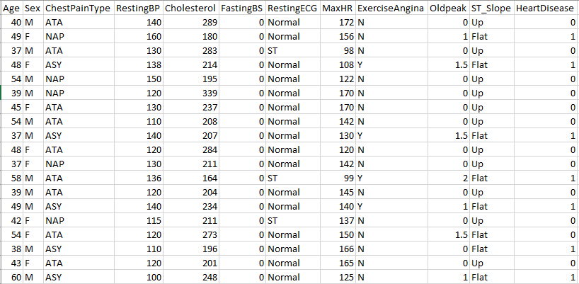
Figure 1: Features

Slide 5
Models
Logistic Regression
L1, L2 Regularization
Polynomial Transformation
SVM
Linear, rbf, polynomial based kernels
Neural Networks
lbfgs, sdg, adam solvers

Slide 6
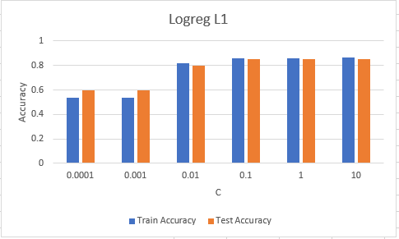
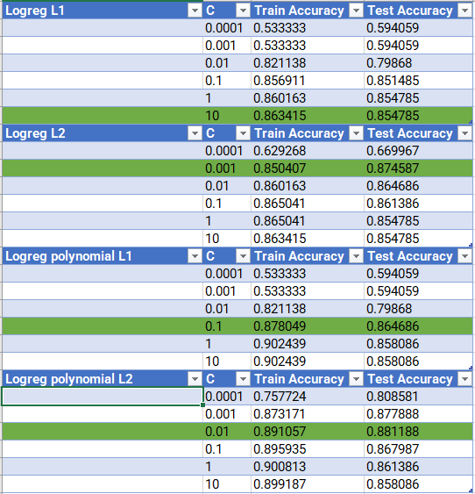
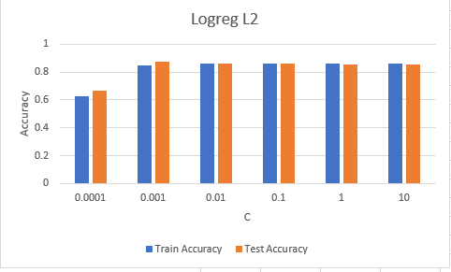
Results
Figure 3: LogReg, L1 Regularization
Figure 2: Results from Logistic Regression
Figure 4: LogReg, L2 Regularization

Slide 7
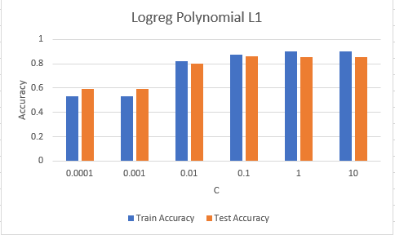
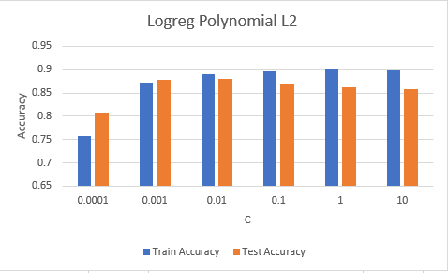
Results
Figure 6: LogReg poly, L1 Regularization
Figure 5: Results from Logistic Regression cont.
Figure 7: LogReg poly, L2 Regularization

Slide 8
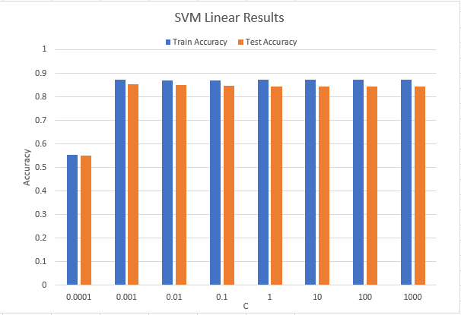
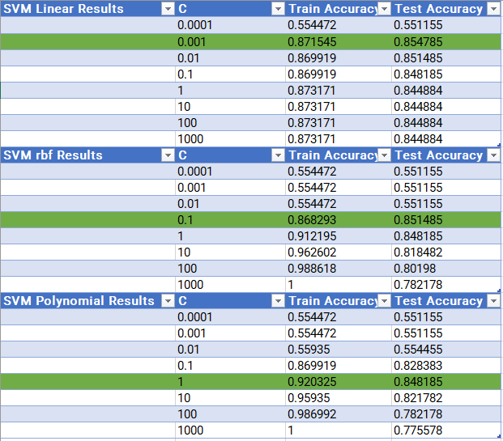
Results
Figure 8: SVM Results
Figure 9: SVM Linear Results

Slide 9
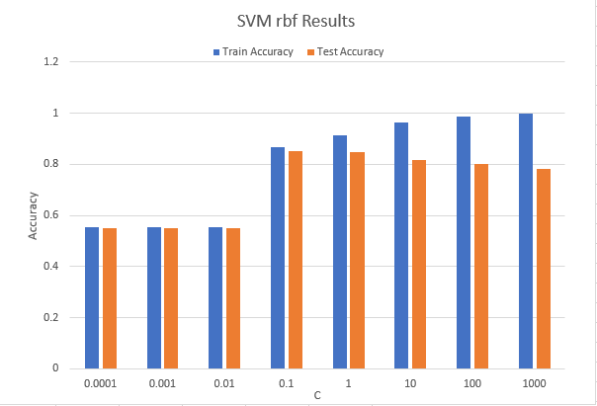
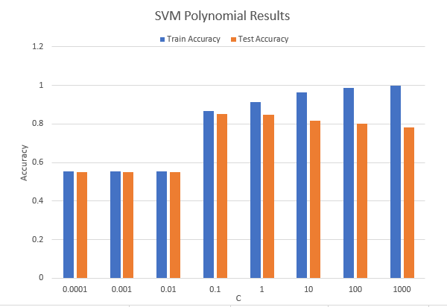
Results
Figure 11: SVM rbf Results
Figure 10: SVM Results cont.
Figure 12: SVM Polynomial Results

Slide 10
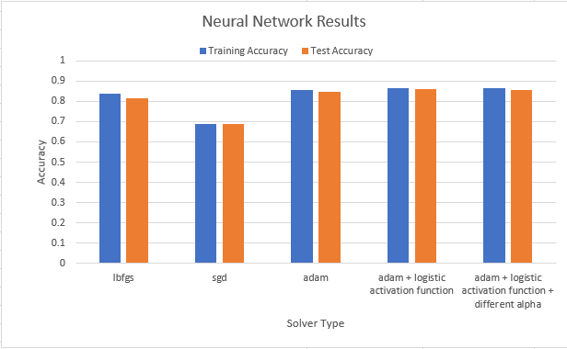
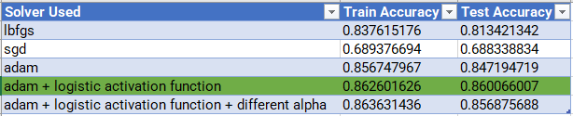
Results
Figure 13: Neural Network Results
Figure 14: Neural Network Graph

Slide 11
Analysis
The model that performed the best for us was the logistic regression model with polynomial transformation and L2 regularization at C = 0.01.
This model yielded a test accuracy of 88.1% while most of the other models averaged around 85%.
Variance was high in some of the models because our sample size was fairly low(only 918 observations) causing our models to sometimes overfit.

Slide 12
Heart Failure Prediction
By: Brian Guo & Winston Yang
Machine Learning Final Project

